Slide 1
Week 6
Classes

Slide 2
Questions?

Slide 3
Agenda

Slide 4
Review
Arrays
Lists
Foreach

Slide 5
What is a class?
A class is an object.
Objects/classes allow us to bundle multiple functions and variables together into an object.
With a class you can create separate versions or instances of an object that have unique properties.
Most variable data types are a type of class.
To create an instance/object of a class you state the class name, the name of the object your creating, and use the “new” keyword to create the instance.
Remember “Random rng = new Random()?”

Slide 6
Creating a class
To create a new public class, you use the public keyword, followed by class, followed by the name for your new class: “public class MyClass { }”
First letter is always capitalized
Inside of the class curly braces you can make any number of variables and methods. These variables and methods will be able to be used by instances of the class.
Once you have a class populated with variables and methods, you have to instantiate an object of that class in whichever script you want to use that class. Remember the format: “ClassName objectName = new ClassName();”
To use the variable or functions of the class you created you use the “.” operator.
“objectName.MyFunction();”
Remember like “rng.NextDouble();

Slide 7
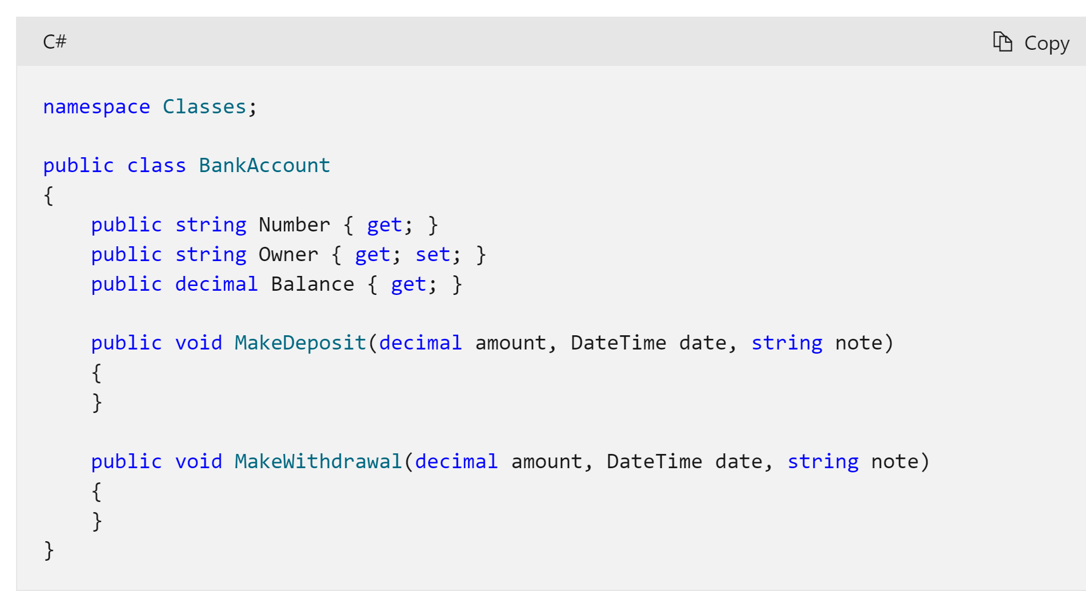
Example of a New Class

Slide 8
Constructors
A constructor is a method that runs whenever you create a new instance of a object. It’s a constructor because it helps “construct” that new object you want to create.
For example, if you need a random player id to be generated each time a player is created, you can use a constructor to do that.
Constructors can take in parameters like any other method. This allows you to pass in data from OUTSIDE the class, to dictate how the class constructs an object.
You can have multiple constructors with different parameters in a class, and the class will pick the appropriate one to use based on the amount of parameters you fill in when you create the instance
Filling in parameters while creating an object can look like this;
“MyClass1 myClassObject = new MyClass1(paramter1, parameter2);”
It has the class name, the object name, the new keyword and the parameters.
A constructor method must have the same name as the class for the system to recognize it as a constructor.
If the class name is MyClass, then the constructor method must be “public MyClass() { }

Slide 9
Steps to Using A Class
Create a class.
Add a constructor method if necessary (not always needed)
Add in the additional variables and methods for the class.
Create an instance of the class on the script you want the object to run on.
Use that instance to call the variables and methods of the class.

Slide 10
Coding Challenges
Create and use a Dog class!
We want to create a custom class called “Dog”.
Inside Dog we want a public variable called name, and 2 methods: Bark and Sit.
In the Bark method, write to the console “Woof Woof”.
In the Sit method, write to the console that the dog sat in front of you using the name variable.
“<name> sat in front of you”
Now, inside of the main method of visual studio, create an instance of your dog class.
Use that instance to get access to the name variable and change its name.
Repeat the above 2 steps and create a second dog with a new name.
Make both dogs bark and sit with the functions provided.
Augment the dog class!
Create an additional breed and age variable for your dog.
Create a constructor that has 3 parameters, one for breed, one for the name and one for age. In the constructor set the breed, name and age equal to the parameters.
Create an Speak function in the class. In this function introduce the dog by it’s name, age and breed.
In your Main() method, erase the line where you set the dogs name manually and instead use the parameters to input the name, age and breed of your dog during object creation.
Create 2 separate dog with different properties and call all 3 of their functions: Bark, Sit and Speak.

